Slide 1
Fantasy Football Regression Model - Using Team and Player Stats to Improve Fantasy Team Performance
David Sciacca
Regis University
Data Science Practicum I – MSDS 692

Slide 2
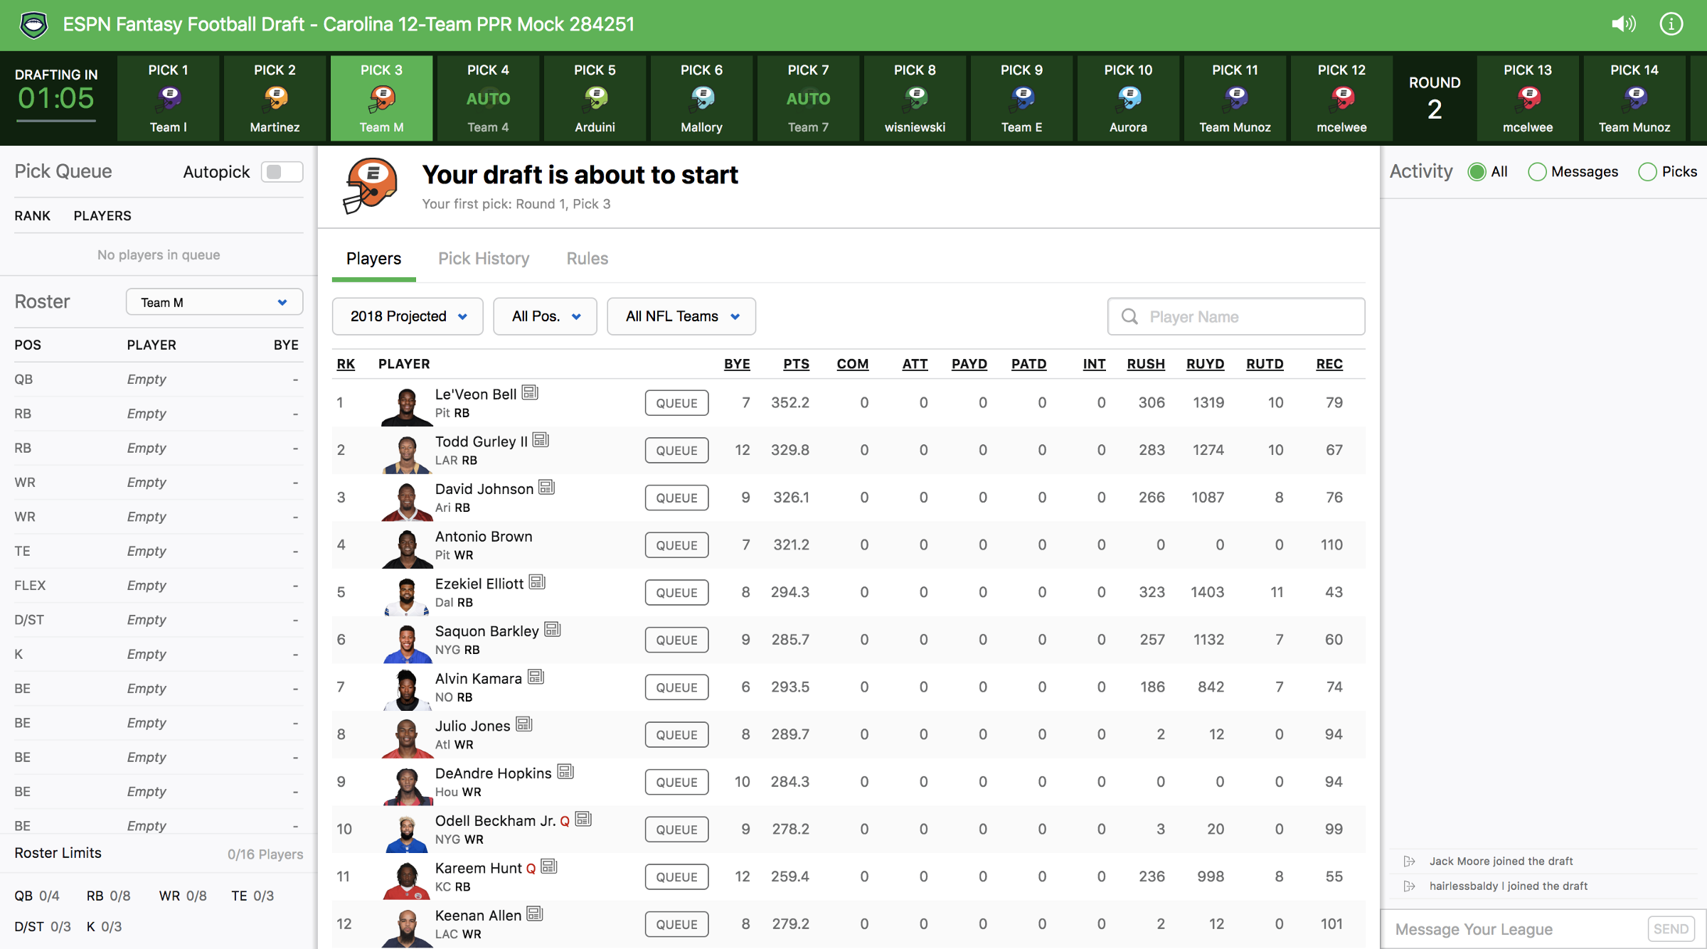
Background
Fantasy Football
Draft players from various teams
Quarterbacks, Wide Receivers, Running Backs, Tight Ends
Kickers, Defensive/Special Teams in some leagues
Player performance translates to fantasy points
Quarterbacks, Running Backs (RB), Wide Receivers (WR), Tight Ends (TE) (ESPN, 2005):
Rushing/Receiving or Kick/Punt/Fumble Return TD = 6 pts
Passing TD = 4 pts
Rushing/Receiving/Passing 2 pt conversion = 2 pts
10 Rushing/Receiving Yards = 1 pt
25 Passing Yards = 2 pt
Bonus Points (player must score TD for bonus points)
Rushing/Receiving/Passing TD of 40 yards or more = 2 pts
Penalty Points
Intercepted Pass = -2 pts
Fumble Lost = -2 pts
Image from: https://productcoalition.com/product-case-study-espns-draft-lobby-redesign-dfe8cdd39fa5

Slide 3
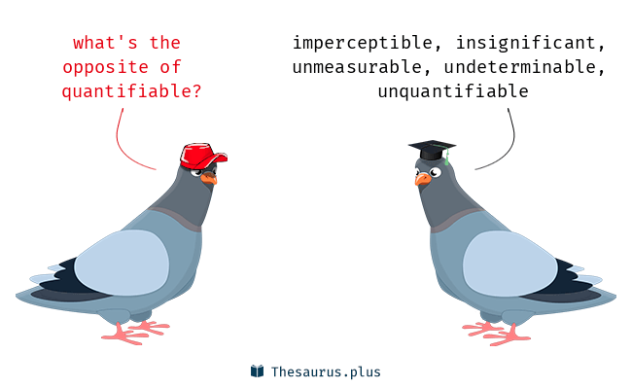
The Problem
Users typically draft based on
Player past year performance
Team/Player preference
Player past year performance quantifiable
Emotional decisions (i.e. Team/Player preference) not quantifiable
Can result in poor fantasy performance
Missed Valuable Insights
Historic team performance
Offseason changes (free agent and draft)
Difficulty of schedule
Etc.
Image from: https://thesaurus.plus/img/antonyms/127/quantifiable.png

Slide 4
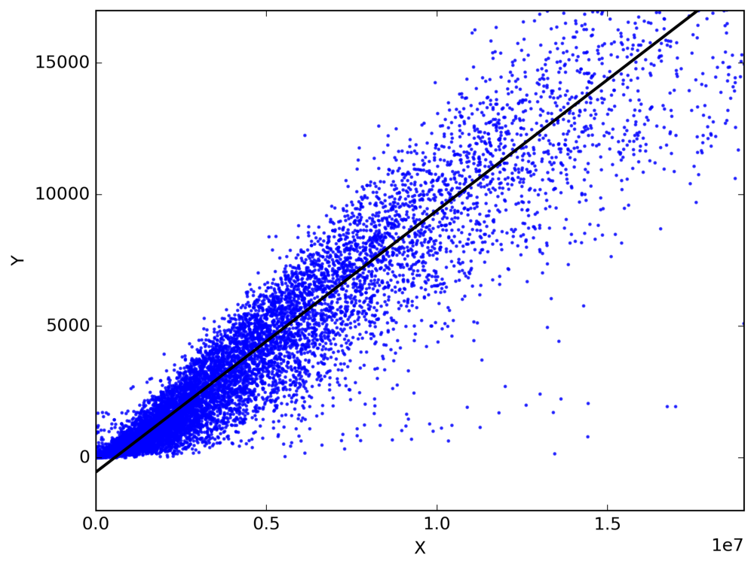
Proposed Solution
Regression model to quantify schedule difficulty
Historic defensive team performance
Which teams are best at stopping positive points?
Stopping TDs
Preventing yards
Which teams are best at producing negative point events
Interceptions
Fumbles
Defensive team strength
Which teams have defenses with more top performers
Image from: https://cdn-images-1.medium.com/max/1000/1*KwdVLH5e_P9h8hEzeIPnTg.png

Slide 5
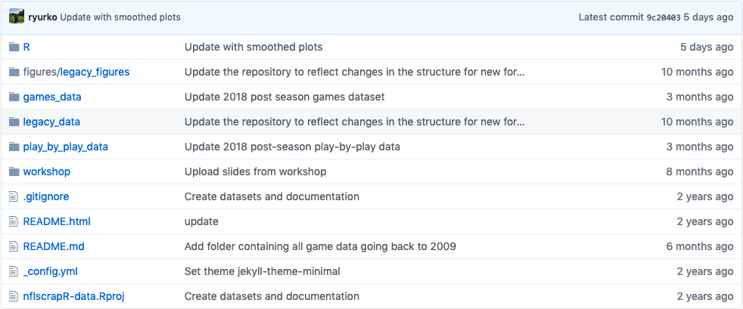
The Data
nflscrapR
freely available NFL team, game, and player datasets (Ryurko, 2019)
Pre, regular, and post season play-by-play datasets from 2009 to 2018
Over 250 columns, thousands of rows
Pre, regular, and post season game datasets from 2009 to 2018
Player statistics by game
Team statistics by game
Player statistics by season
Team statistics by season

Slide 6

The Data (cont.)
Pro Football Focus (PFF, n.d.)
General defensive team statistics
Passing defensive team statistics
Rushing defensive team statistics
Defensive player statistics by positional group – includes professional football analyst scores by player
Defensive Interior (DI)
Defensive Edge (Edge)
Linebacker (LB)
Safety (S)
Cornerback (CB)
Image from: https://yt3.ggpht.com/a/AGF-l7-NsMyHjWxZvYZ6nCRT-0mql9hBMY-mCu2Oew=s900-mo-c-c0xffffffff-rj-k-no

Slide 7
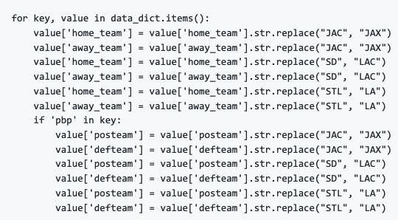
Data Cleaning
PFF data – already very clean
nflscrapR play-by-play data
Null value handling
Dropped columns with 80%+ null values
Inconsistent team names
Jaguars, Chargers, and Rams

Slide 8
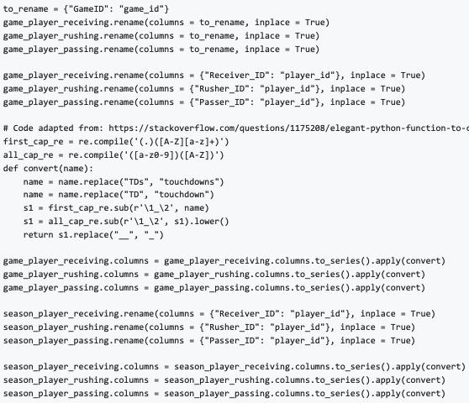
nflscrapR Data Cleaning (cont.)
Inconsistent column names between datasets

Slide 9
nflscrapR Data Cleaning (cont.)
Goal = score teams on ability to stop TDs, limit yards, and produce interceptions/fumbles
Reduced datasets to relevant features
Games data: home_team, away_team, home_score, and away_score
Combined game data into single dataset
Play-by-play data: home_team, away_team, posteam, defteam, drive, yards_gained, air_yards, yards_after_catch, interception, touchdown, pass_touchdown, rush_touchdown, fumble, total_home_score, total_away_score, posteam_score, defteam_score, posteam_score_post, and defteam_score_post.
Combined pbp data into single dataset
Player stats by game data (rushing/receiving): team, opponent, total_yards, fumbles, and touchdowns
Players stats by game data (passing): team, opponent, attempts, completions, total_yards, touchdowns, and air_touchdowns
Player stats by season not useful – only MVP data

Slide 10
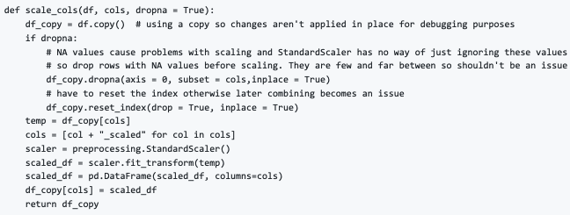
Exploratory Data Analysis
Scale all numeric columns
Applied UDF to all numeric columns in all datasets

Slide 11
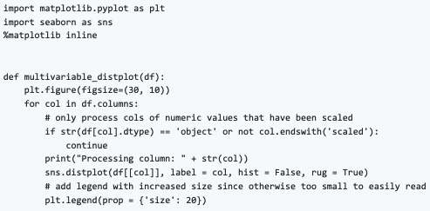
EDA (cont.)
Visualize distributions of data
Wrote UDF to visualized distributions on single plot

Slide 12
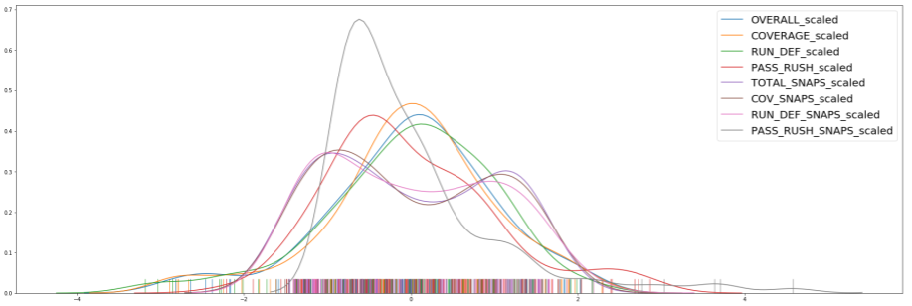
EDA (cont.)
Example multivariable distplot from Safeties Dataset

Slide 13
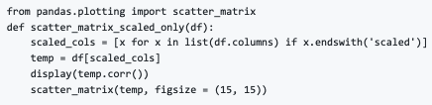
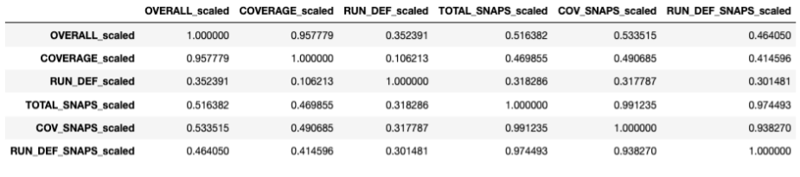
EDA (cont.)
Examined and visualized correlations
Wrote UDF to view correlation coefficients and scatter matrix amongst scaled variables
Applied to all datasets
Example output from CB dataset (continued on next slide)

Slide 14
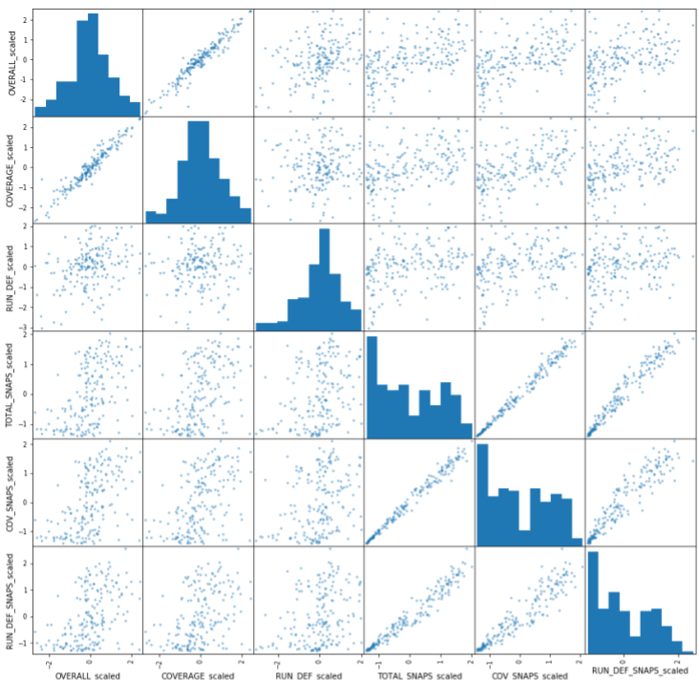
EDA (cont.)
Example output continued:

Slide 15
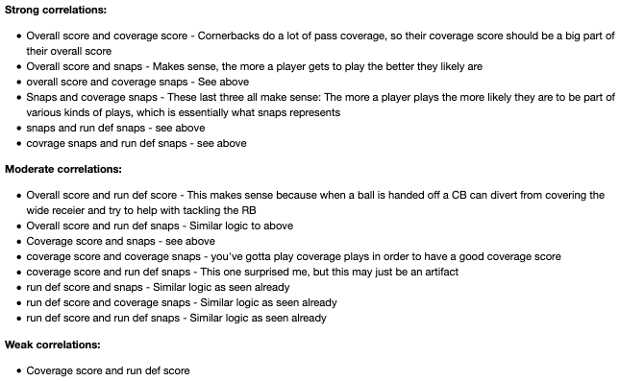
EDA (cont.)
Analyzed and interpreted correlations. CBs example:

Slide 16
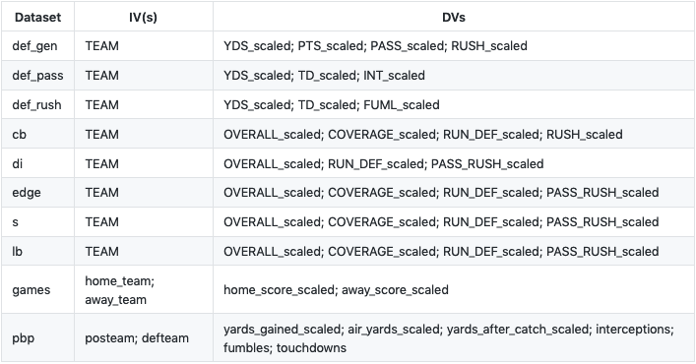
The Model
Couldn’t practically combine all data into one dataset, opted to make multiple models and amalgamate scores
Established potential IVs and DVs for models

Slide 17
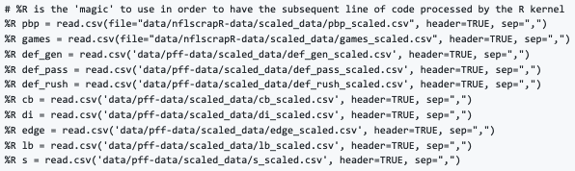

The Model (cont.)
More familiar with regression in R, so built models in R then create Python DFs using model coefficients
Read data into R kernel
Created lm() models and put model coefficients into Python DFs

Slide 18
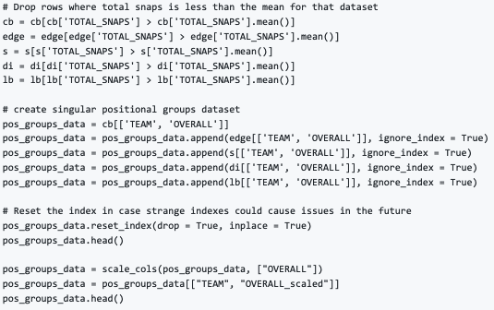
The Model (cont.)
Adapted PFF data to make more useful
Removed players with relatively little game time
Combined team and overall score into singular positional groups dataset
Rescaled overall score column

Slide 19

The Model (cont.)
Built logistic regression models with glm() for binary columns
Interceptions, TDs, and fumbles
Team is categorical, so converted to dummy variable
All coefficients in relation to intercept/baseline
Added intercept/baseline value to coefficients to get a ‘true’ score
Merged resulting scores into single dataset

Slide 20
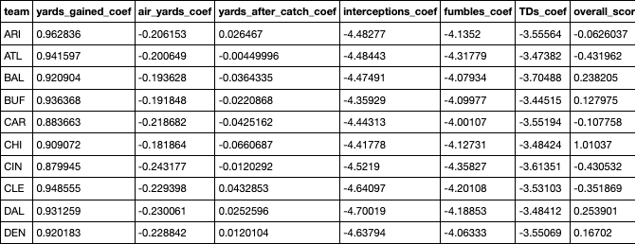
The Model (cont.)
Snippet of DF after merge
Since binary columns (i.e. TDs, fumbles, Interceptions) on different scale, scaled columns one more time

Slide 21

The Model (cont.)
Events are worth different points, so weighted columns accordingly
No weight for TDs
Multiple yard columns, yards overall worth less, but more common means of scoring points, so no weight
Fumbles and interceptions worth negative points, occur as often as TDs, but worth -1/3 the points, so weight by -1/3
Overall score from PFF signals overall team strength, higher score = stronger defense, so weight by -1

Slide 22
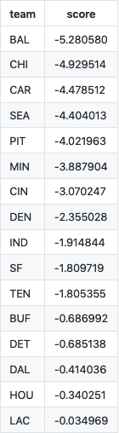
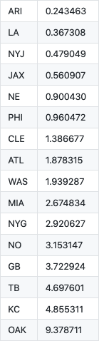
The Model (cont.)
Obtained overall team score by summing columns of coefs_weighted DF
Sorted values to get idea of best defenses versus worst

Slide 23

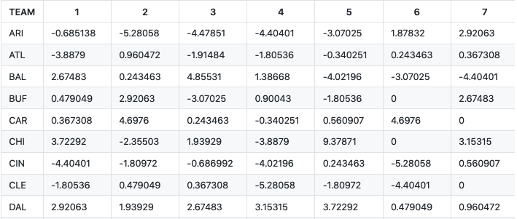
The Model (cont.)
Obtained upcoming NFL season schedule and replaced opposing team with defensive score
Snippet of resulting schedule dataset

Slide 24
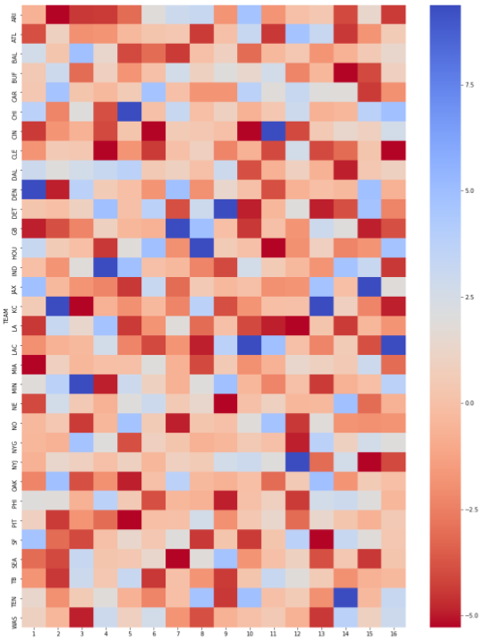
The Model (cont.)
Created heatmap from resulting schedule dataset
Red indicates playing a strong defense, thus more difficult game
Blue indicates playing easy defense, thus easier game

Slide 25

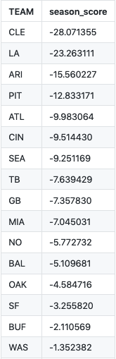
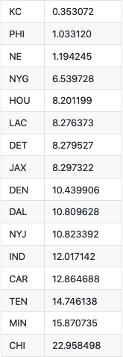
The Model (cont.)
Summed scores across schedule dataset to get overall season difficulty score by team
Output of sorted results

Slide 26
Findings
Teams with toughest season
Cleveland Browns
LA Rams
Arizona Cardinals
Pittsburg Steelers
Atlanta Falcons
Teams with easiest season
Chicago Bears
Minnesota Vikings
Tennessee Titans
Carolina Panthers
Indianapolis Colts

Slide 27
Next Iterations
Isolate running and passing defense scores to create running and passing strength of schedule models
Allow for selecting RBs and TEs based on running model
Allow for selecting WRs, QBs and TEs based on passing model
Model on offensive team strength
Provide another factor to consider for similarly scored teams

Slide 28
References
ESPN. (2005, June 23). Rules - Standard Scoring System. Retrieved June 30, 2019, from https://www.espn.com/fantasy/football/ffl/story?page=fflrulesstandardscoring
PFF. (n.d.). NFL, Fantasy Football, and NFL Draft | Pro Football Focus. Retrieved June 30, 2019, from https://www.profootballfocus.com/
Ryurko. (2019, March 18). [NflscrapR Data]. Raw data.

